Slide 1

3D MODULAR PRECAST ELEMENTS AN “OUT OF BOX” CONSTRUCTION APPROACH

Slide 2
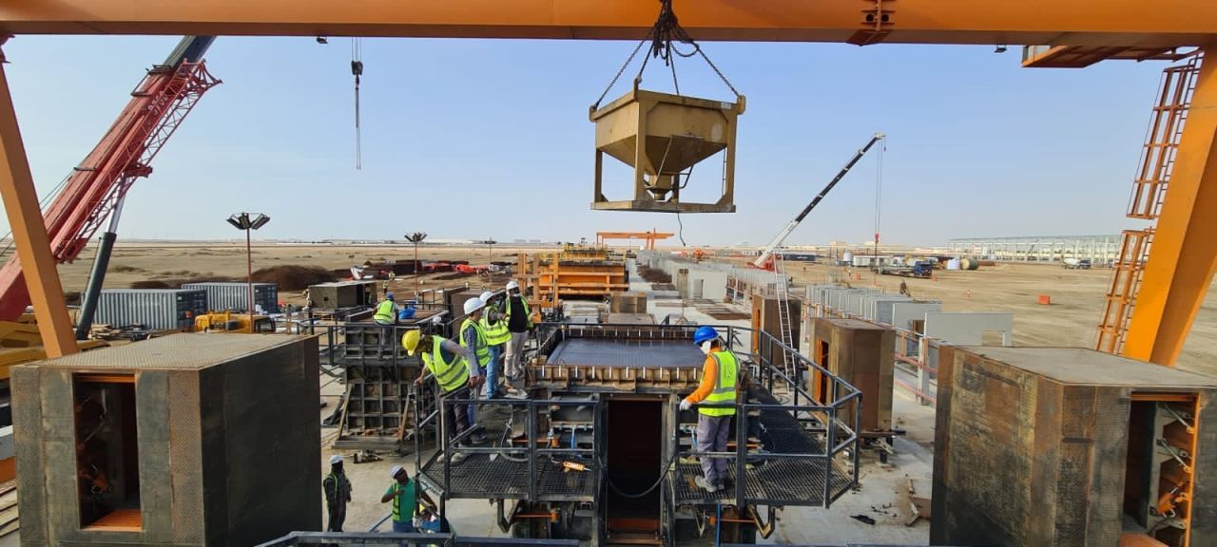
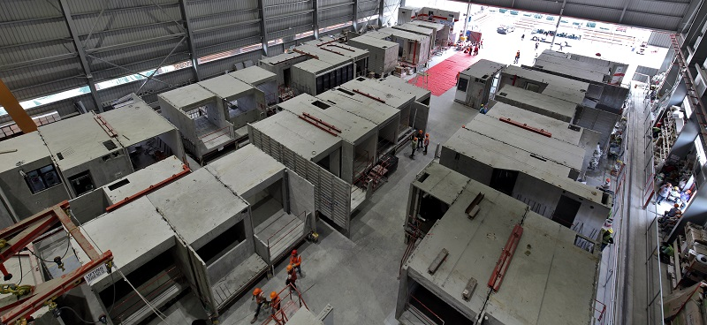

Slide 3
An “Out of Box” Construction Approach
Use of 3D Modular Precast Elements (On site/Offsite) pre-finished elements specifically in Kitchen, Toilet and Bathroom areas.
Standardization of Kitchen, Toilet and Bathroom areas with variation in Living and Bedroom areas in a Building for large scale projects or High rise Building.
3D Modules or PODs are three-dimensional units monolithically casted with walls and slabs in controlled factory conditions.
This type of system eliminates the problems inherent in 2D large panel based construction by minimizing the number of joints, connections –Root cause for leakages, seepages, lack of ductility etc.

Slide 4
Precast Technology - Current Scenario in India
Precast Concrete Technology is being used in India majorly by Private Players since last 10 years or so
The Precast concrete construction adopted in India is using 2D elements like walls and floor slabs
During this period (2010-2020) approximately 100 M sqft of Precast concrete construction was carried out which is even less than 2% of total size of construction industry
Even though Precast Concrete Technology offers some distinct advantages like time saving & better quality of construction, it is not as popular to it’s potential in India so far

Slide 5
Shortcomings of 2D Precast Concrete Technology in Indian Context
High Indirect Cost per sqft (Capital Investment, Plant Maintenance)
Viable only for minimum speed of 1M sqft BUA per annum and maximum of 3.5M BUA sqft per annum
Approximately 5-10% higher structure cost due to,
Expensive Connections (Grouts, Sealant, hardware)
Higher Crane costs due to higher number of elements per apartment
Higher cost of transportation (element transportation is additional)
Concerns' of industry professionals specifically w.r.t.,
  Leakages at Joints if not maintained
  Lack of ductility (non-monolithic structure)
Lack of Standardization in Architectural Designs
Laborious finishing work after structure completion
Taxation

Slide 6
3D Modular Precast Elements
3d Modular Precast Elements is a revolutionary method of building construction, which allows use of large sized modules (with perimeter wall & bottom slab) produced offsite under controlled environment
Such 3D elements form the primary structural system in resisting vertical as well as lateral loads. Improves structural performance of the Building
These Modules are delivered to site with all internal finishes and cosmetic fittings which ultimately enables in bringing the certainty in delivery of the project.

Slide 7
Advantages of 3D PODs
Lower Indirect cost (Due to standardization of Kitchen & Toilet Units)
The system is scalable (300 apartments per annum to 25000 apartments per annum)
The Cost is saved as compared to 2D due to following,
    Reduction in connections (50%)
    Reduction in Crane cost due to lower number of elements per apartment
    Reduction in Transportation cost (Optimum use of trailor capacity)
Improved Structural Behavior due to,
  Lesser no of joints
  Better ductility due to monolithic joints
Saving in lead and lift of finishing material & labor in Kitchen & Toilets
Water Leakages can mostly be eliminated, Sunken requirements can be possible with this system.
Better Structural Robustness in Building

Slide 8
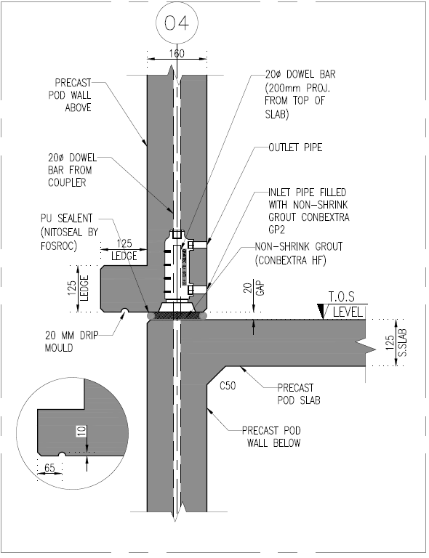
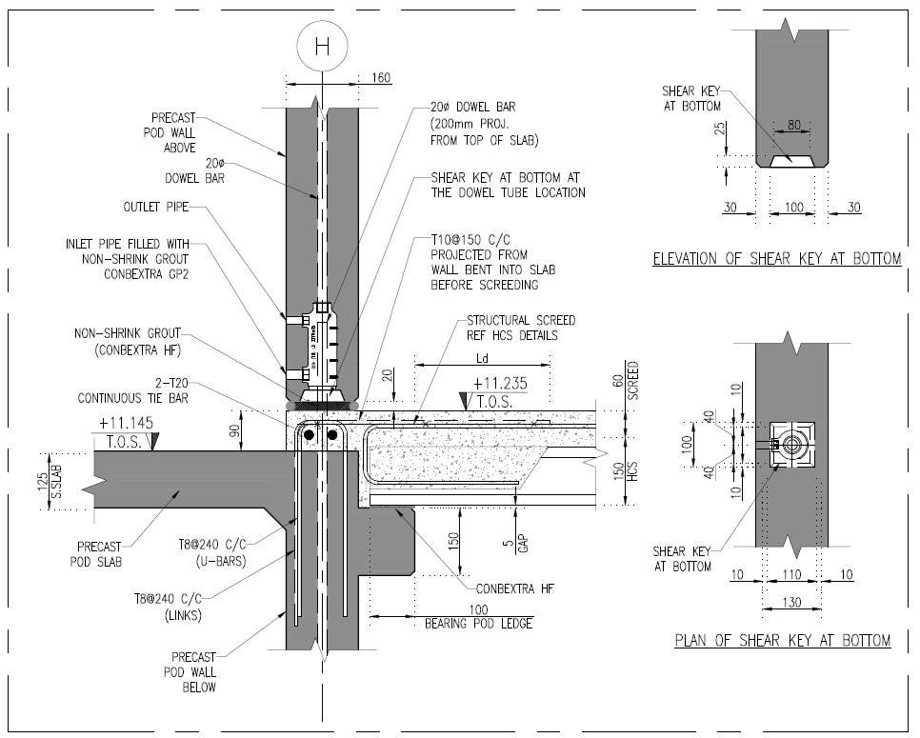
Structural Design and Connections
Structural analysis and design is done as a regular building. Detailing of connections needs more attention.
Horizontal Joint between POD walls through Mechanical Splice Sleeve Grouted Connection
3D POD connection Floor slabs.
(POD with Top slab)

Slide 9
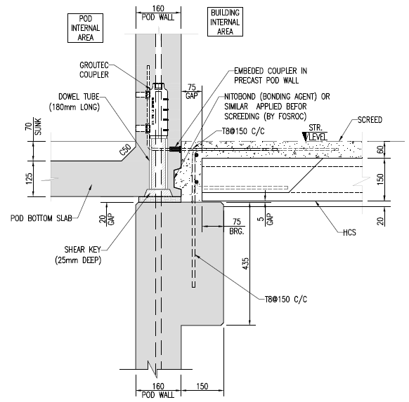
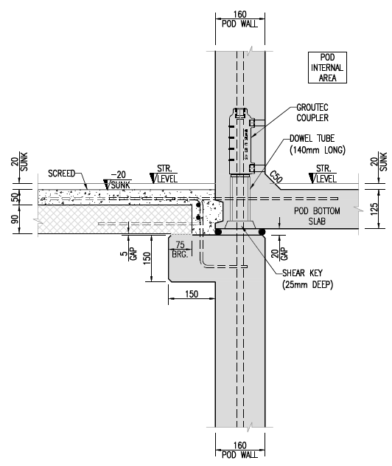
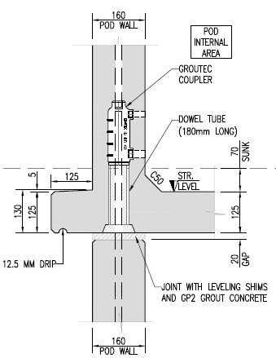
Typical Connections in POD with Bottom slab

Slide 10
Precast 3D Elements Production, Logistics and Erection

Slide 11
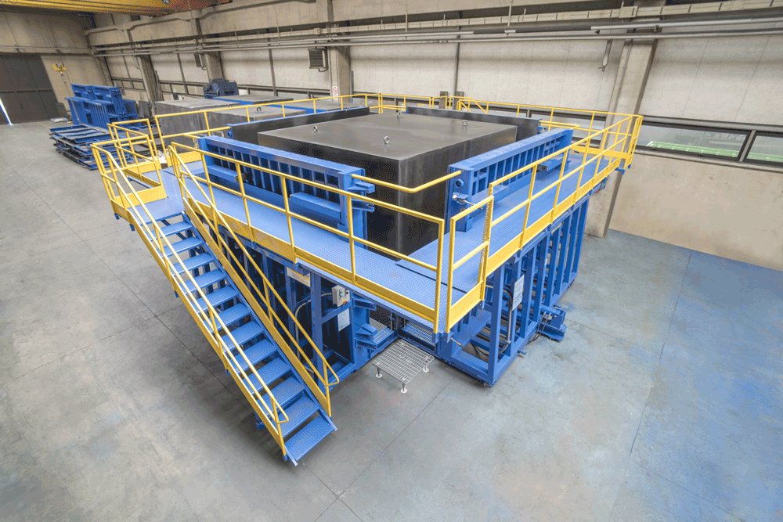
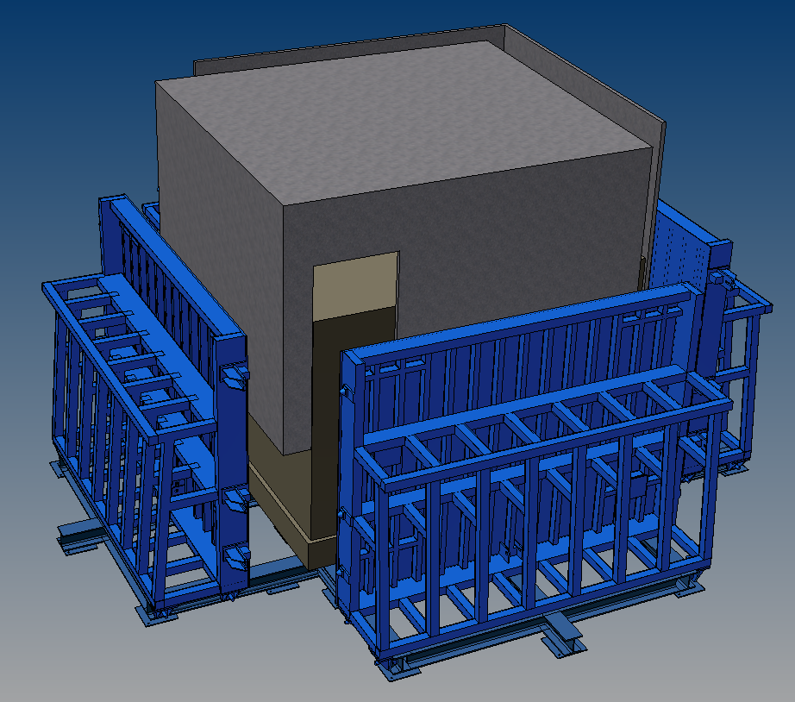
3D Pod Production –Mould for Top Slab

Slide 12
3D Pod Production process- Fast Track Projects
Production of 3D Pod element is done in two stages
Casting of Base slab
Casting of peripheral walls
Mould for 3D Precast Elements have stationary base with flexible external shutters and collapsible internal shutters.
Complete reinf. cage is made with base and peripheral walls by using weld mesh.
Reinforcement cage is transferred to stationary base and base slab is casted with MEP service fittings.
The stationary base is transferred to next station for peripheral wall MEP fittings and casting.
Casting of walls done with Self compacting concrete.
Demoulding of POD done and transferred to steam curing chamber.
After achieving the 50-60% concrete strength, The 3D POD is moved to POD finishing area.
POD is finished with partition walls, tiling, cosmetic and dispatched to site for Erection.

Slide 13
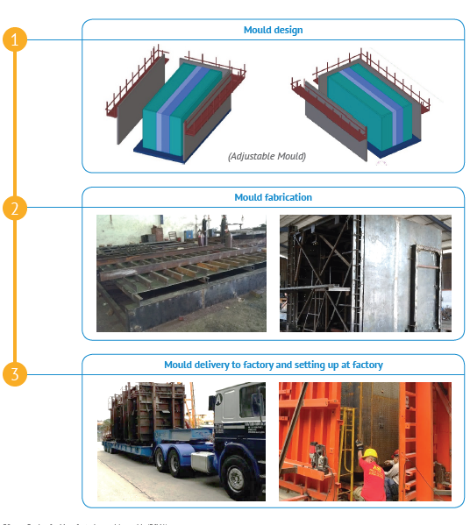


Slide 14
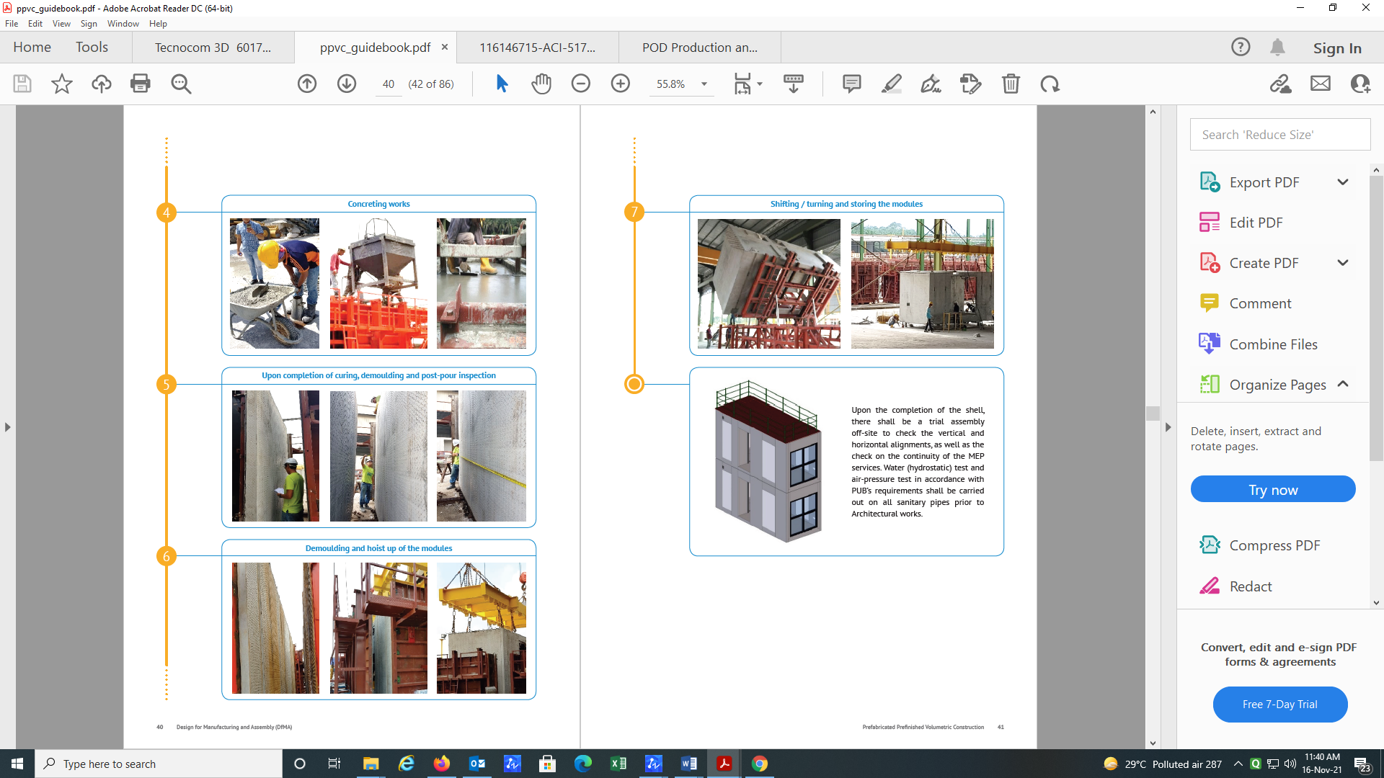


Slide 15
Stacking and Transportation of 3D Pods

Slide 16
Erection of 3D Pods

Slide 17
USE OF “OUT OF BOX”IN ON-GOING INDIAN PROJECTS

Slide 18
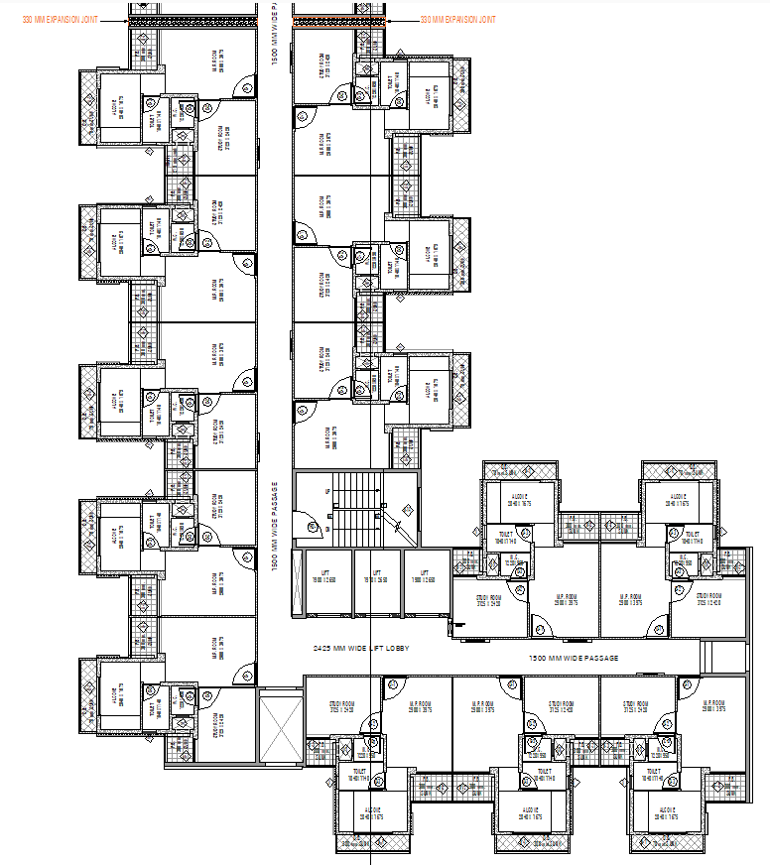
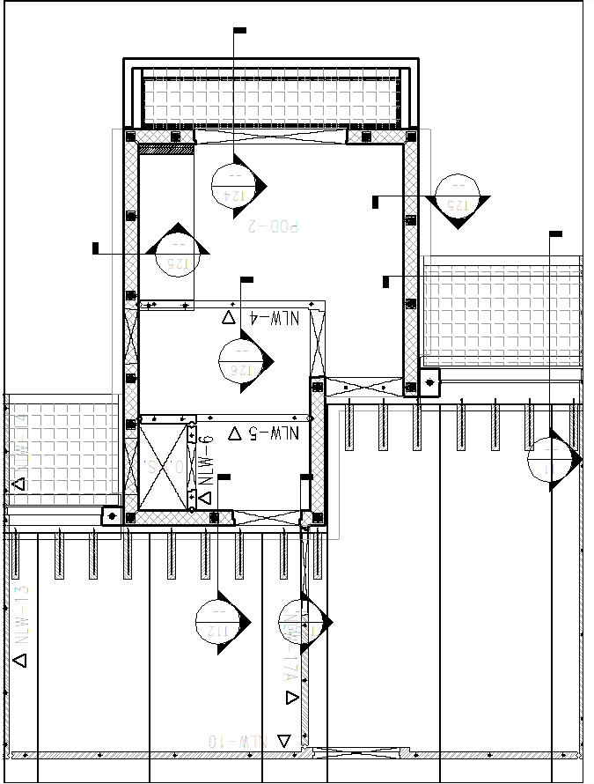
Suraksha Smart City (Vasai )
Structural Unit Plan
Structural Plan
Toilet and Kitchen Pods
Gable End 2D walls
Lift & Stair Core
Corner Core

Slide 19
Structural System
3D Pods –(Kitchen and Toilet pod with 4.3x3 m size Box)
These 3D Pods are Main load resisting system in the Building.
Pod walls = 160 mm thick & Pod Bottom Slab = 125 mm thick
2D walls = 160 mm thick
Each Pod either direction are connected with HCS slabs of 150 mm thick + 75 mm screed.
Central Core stair and Lift Core are inter connected each other in both the directions.
Pre-stressed HCS slabs are connecting between Kitchen & Toilet Pods with the help of screed.
All the floor slabs and walls are connected through the Tie reinforcement as specified in IS 15916:2016.

Slide 20
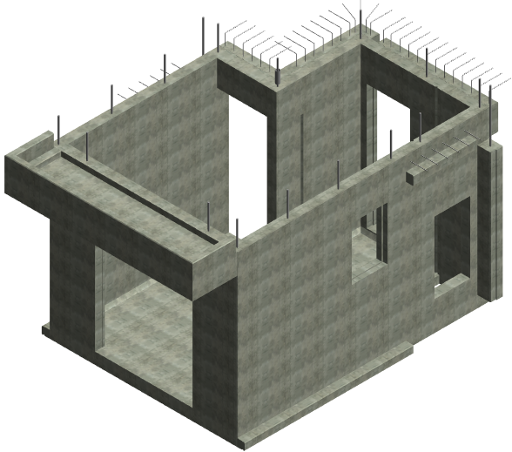
Typical 3D POD Isometric view
Toilet and Kitchen POD

Slide 21
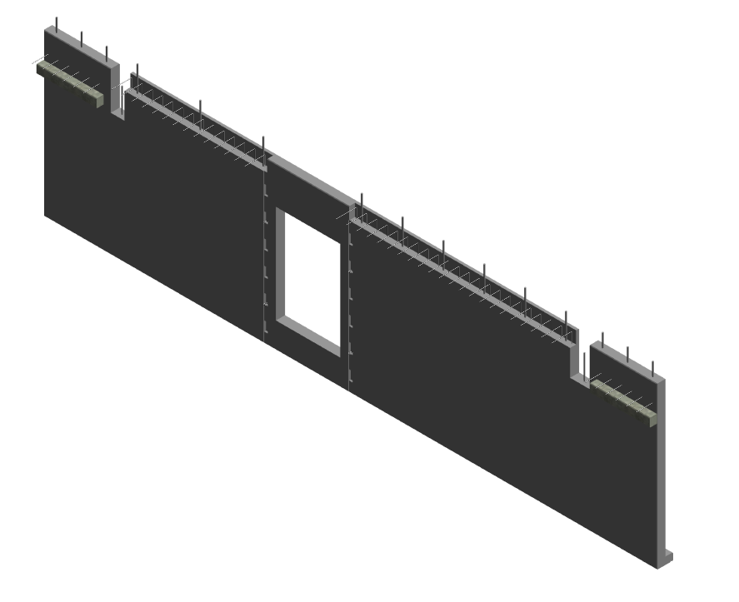
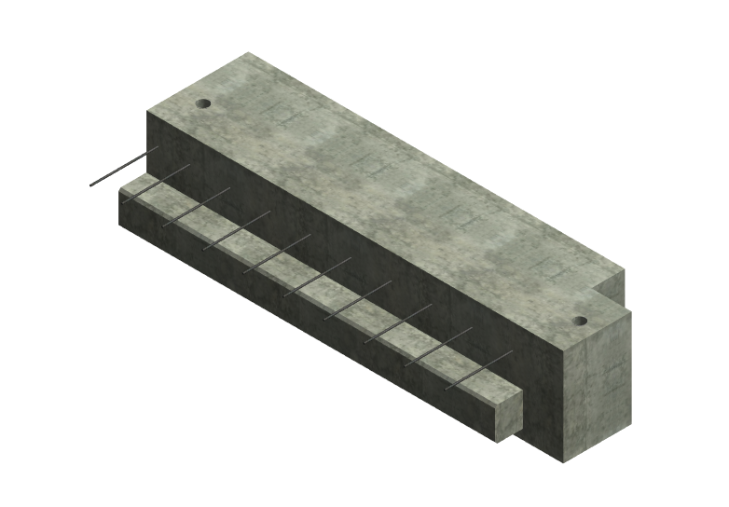
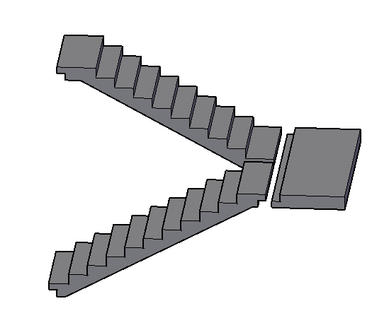
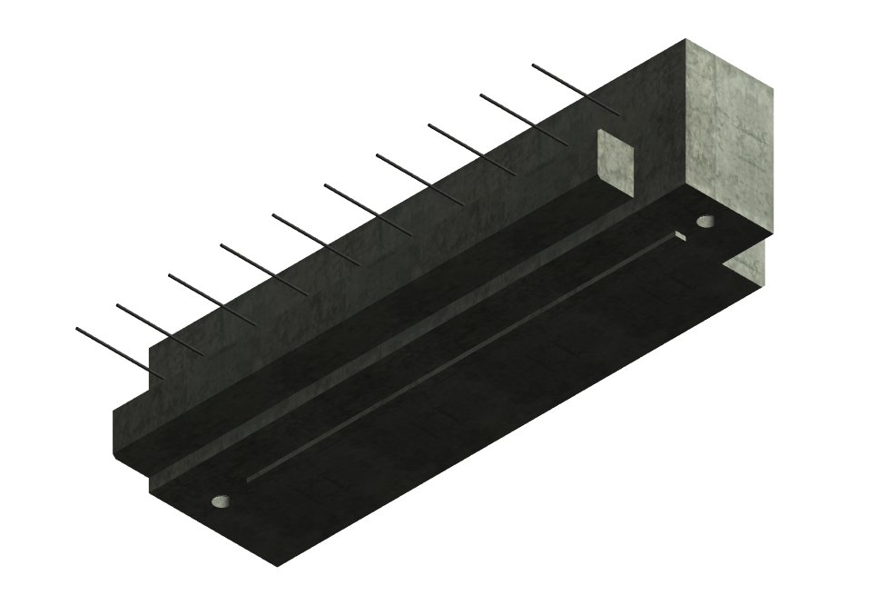
2D wall
Beam
Stair Flight
Beam

Slide 22
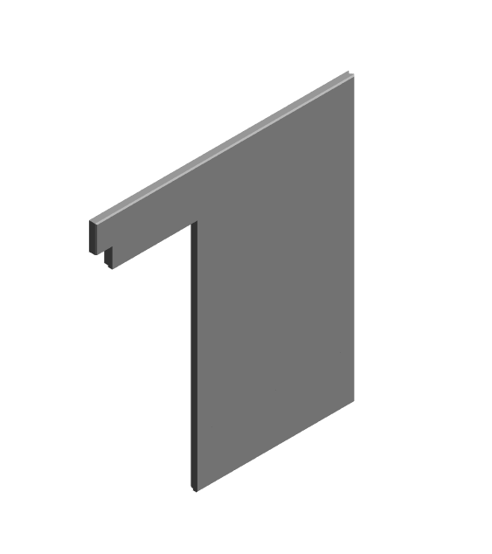
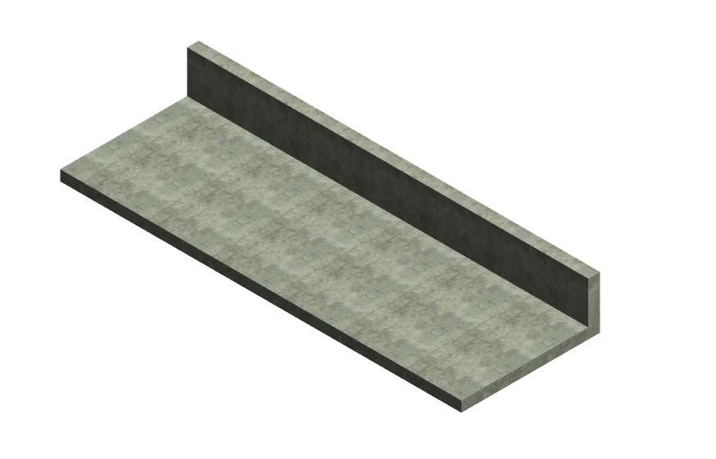
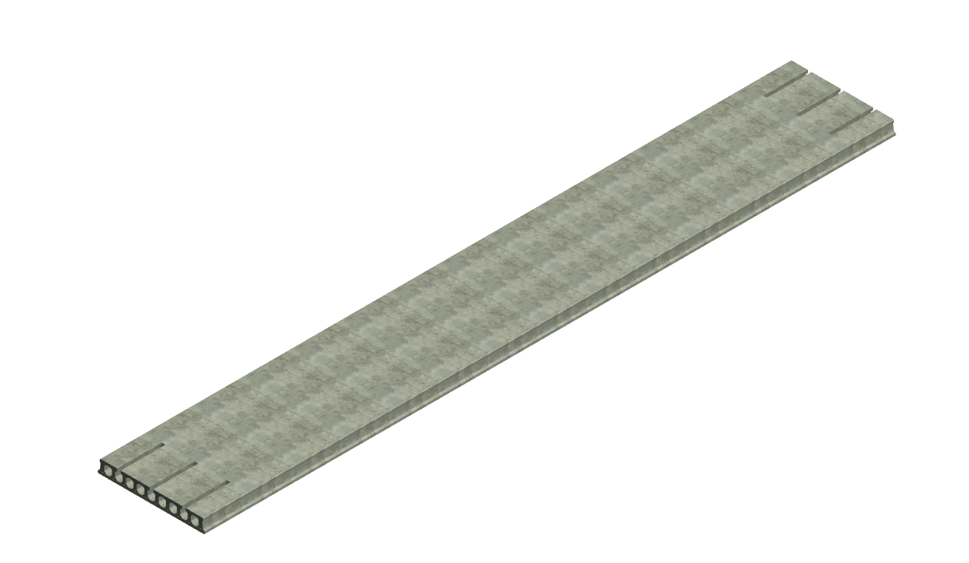
Non Load Bearing wall
Solid Slab
Hollow core slab

Slide 23
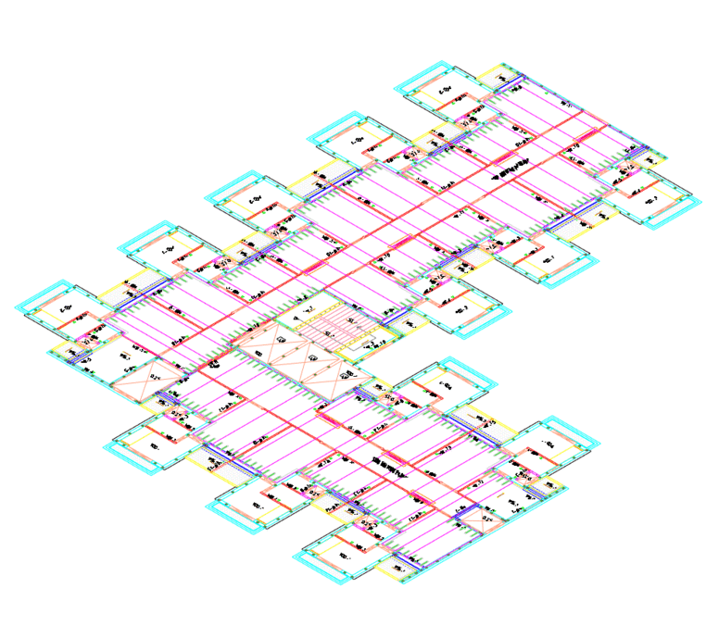
BUILDING ERECTION ANIMATION

Slide 24
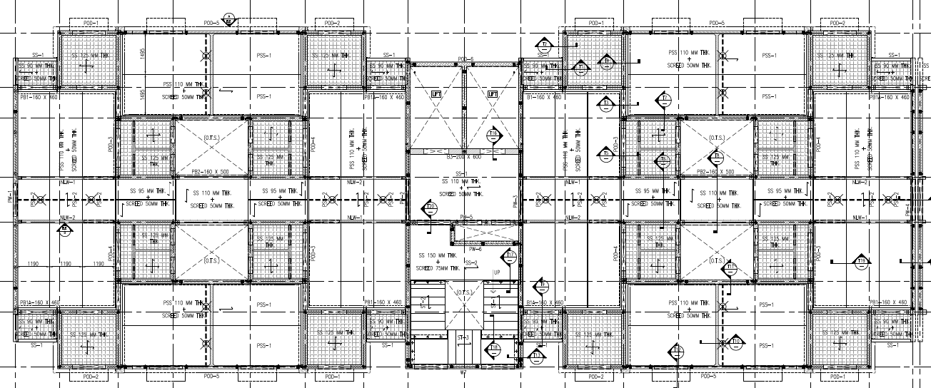
LHP (Ranchi)
Structural Plan
Left Gable End wall
Right Toilet and Kitchen Pods with I Pod
Central Core
Lift and Stair
Left Toilet and Kitchen Pods with I Pod
Right Gable End wall

Slide 25
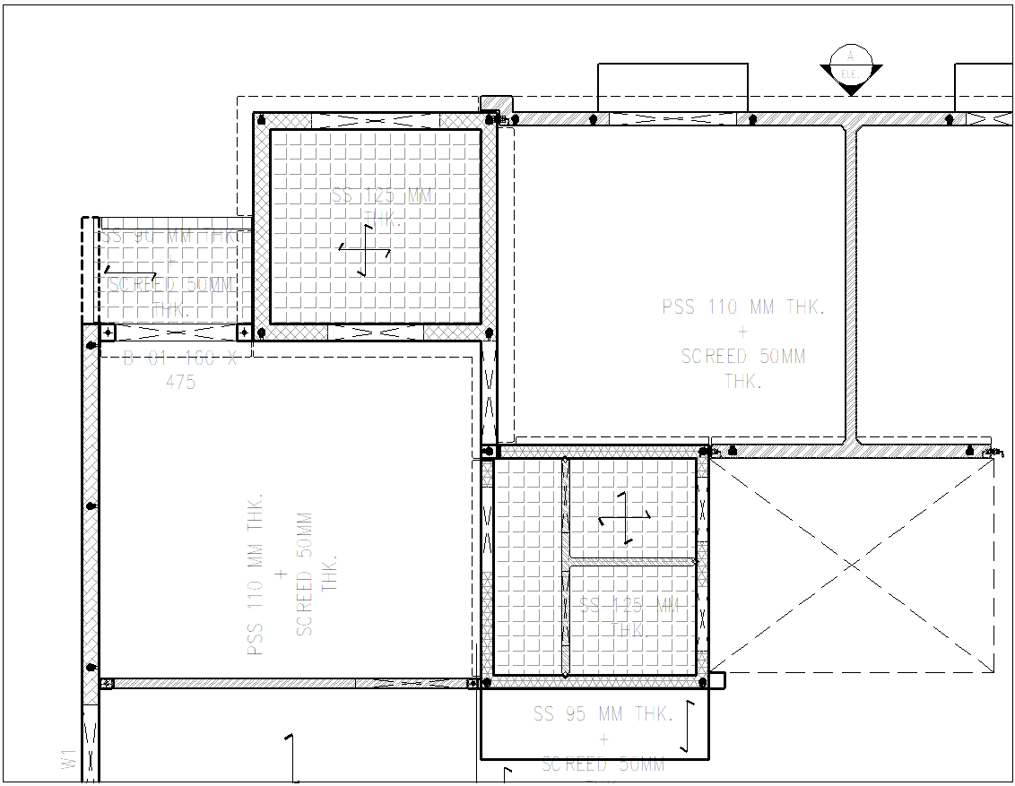
LHP (Ranchi)
Structural Unit Plan

Slide 26
Structural System
3D Pods –(Kitchen and Toilet pod with 2.3x2.3 m size Box)
These 3D Pods are Major Load resisting system in the Building.
Pod walls = 160 mm thick & Pod Bottom Slab = 125 mm thick
Kitchen Pods (Perimeter Pods) are connected with 125 mm thick lateral load resisting (I shape) Pod between the two flats of kitchen pod.
Central Core stair and Lift walls are 160 mm thick
Pre-stressed slabs of 110 mm thick are connecting between Kitchen Pods with the help of 50 mm thick screed.

Slide 27
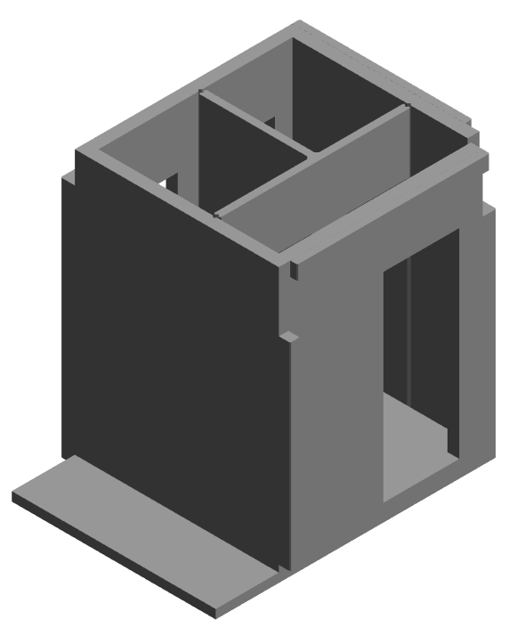
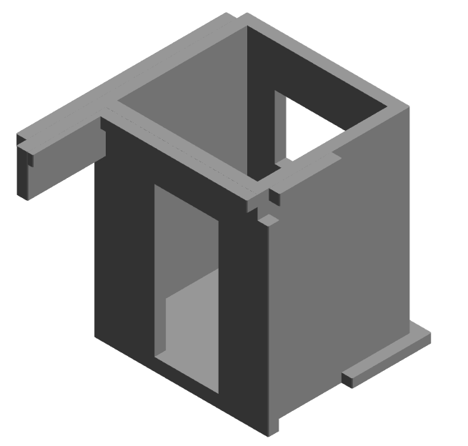
Typical 3D POD Isometric view
Kitchen POD
Toilet POD

Slide 28
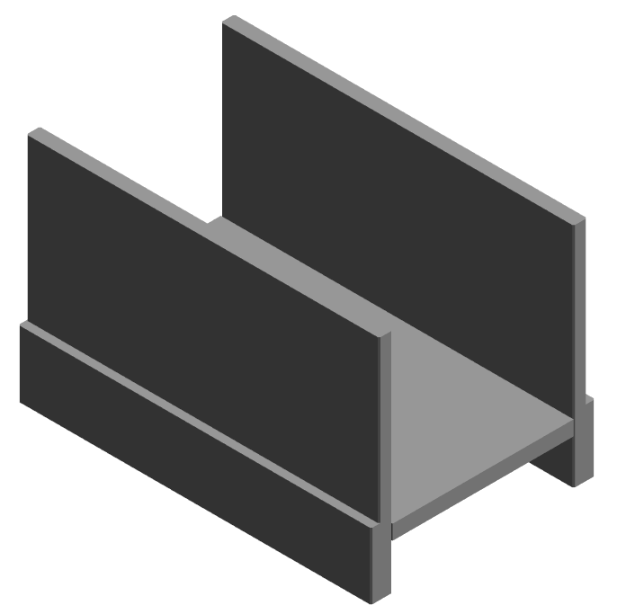
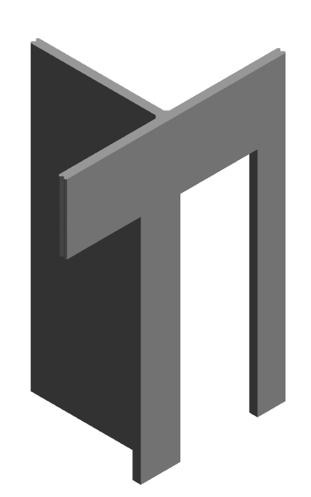
Beam with Slab
T shape wall

Slide 29
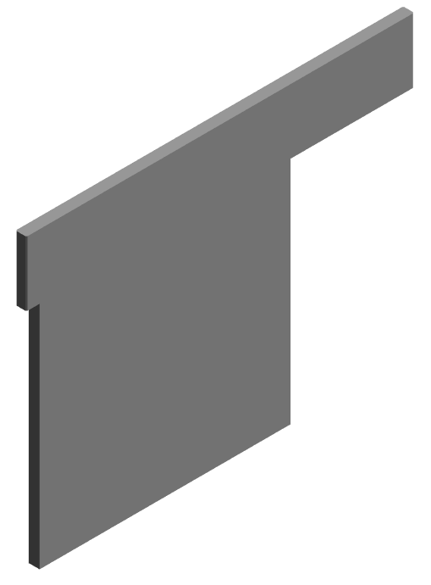
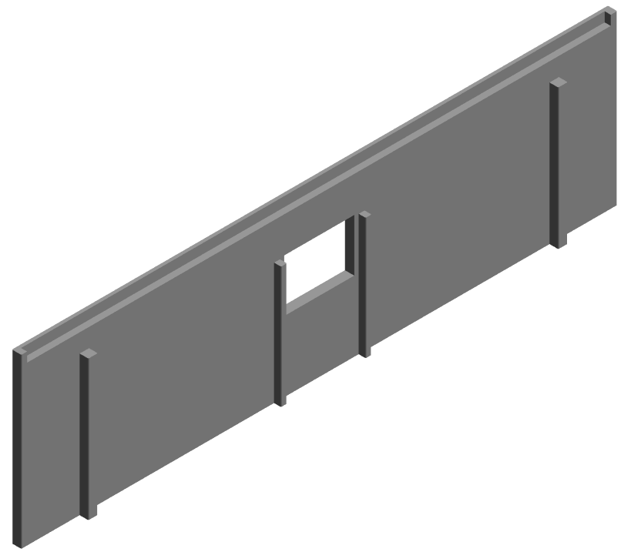
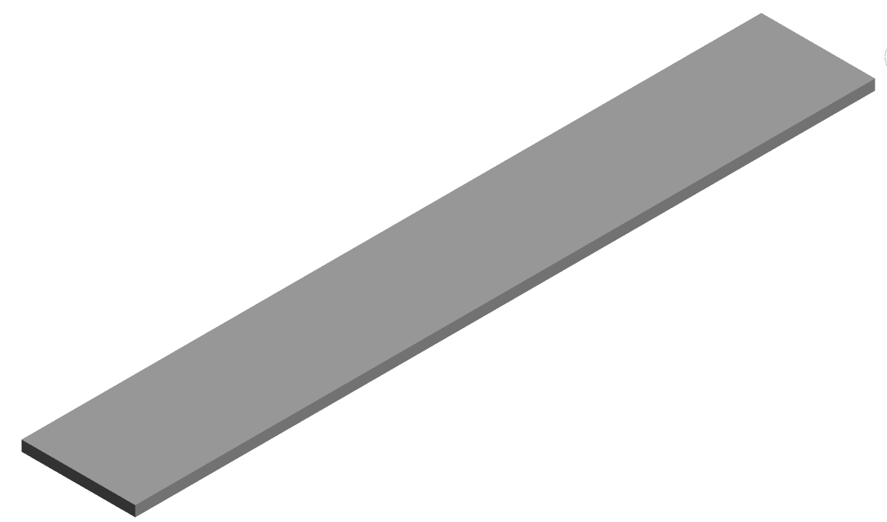
2D wall
Non Load Bearing wall
Solid Pre-stressed Slab

Slide 30
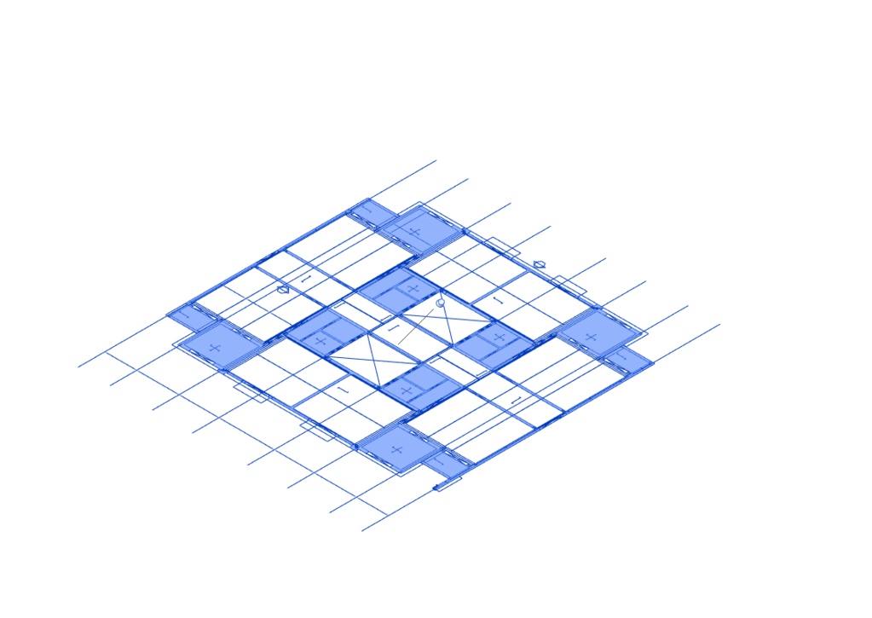
BUILDING ERECTION ANIMATION

Slide 31
SALIENT FATURES
LHP Ranchi | Suraksha Smart City Vasai
BUA = 450000 SFT | BUA = 40 Million SFT
G+8 floors | Stilt+23 floors
No. of Apartments = 1000 | No. of Apartments = 1 Lakh
No. of Elements per Apartment = 9 | No. of Elements per Apartment = 13
Structure completion = 1 year | Structure completion = 5 Years
Speed of construction = 4 Flats per day | Speed of Construction = 80 Flats Per day
BOQ of superstructure (Including Partition walls) Concrete = 0.04 m3/sft Steel = 3.0 kg/sft | BOQ of superstructure (Including Partition walls) Concrete = 0.04 m3/sft Steel = 3.5 kg/sft

Slide 32

“Saurabh Purandare”
Founding Director
Our office

Slide 33
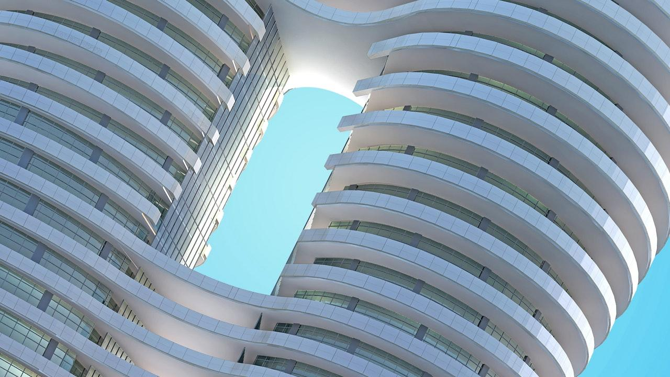
THANKS!
Any questions?
You can find me at:
saurabh@innovela.in
info@innovela.in
+91-2026150618
+91-9689141416

